Slide 1
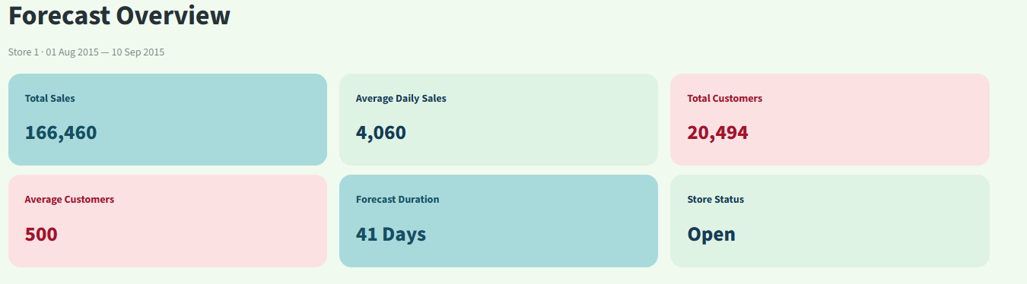
1ST NOVEMBER 2026
ROSSMAN
SALES
BY SIDDHEYA LOHAR

Slide 2
OBJECTIVES
Project objectives:
  Analyze historical sales and customer behaviour.
  Identify factors influencing retail performance.
  Develop machine learning models to forecast sales and customers.
  Evaluate models using appropriate performance metrics.
  Build an interactive forecasting application.
Key challenges:
  Fluctuating daily sales.
  Seasonal demand variations.
  Promotion and holiday effects.
  Differences in customer traffic across stores.
  Competition between retail locations.

Slide 3
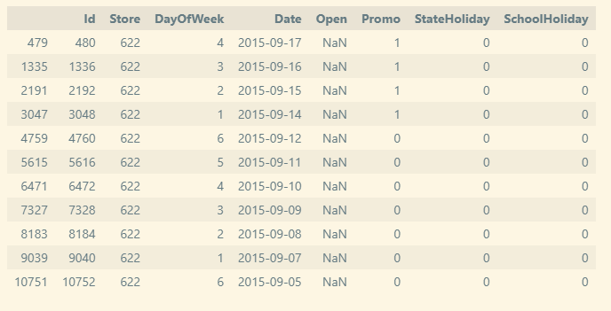
DATA STATS
Training dataset
1,017,209
Testing dataset
41,088
Store metadata
1,115 stores
Training period
Jan 2013 – Jul 2015
Testing period
Aug 2015 – Sep 2015
FEATURES
Sales
Customers
Promo
StateHoliday
Date
DATASET OVERVIEW

Slide 4
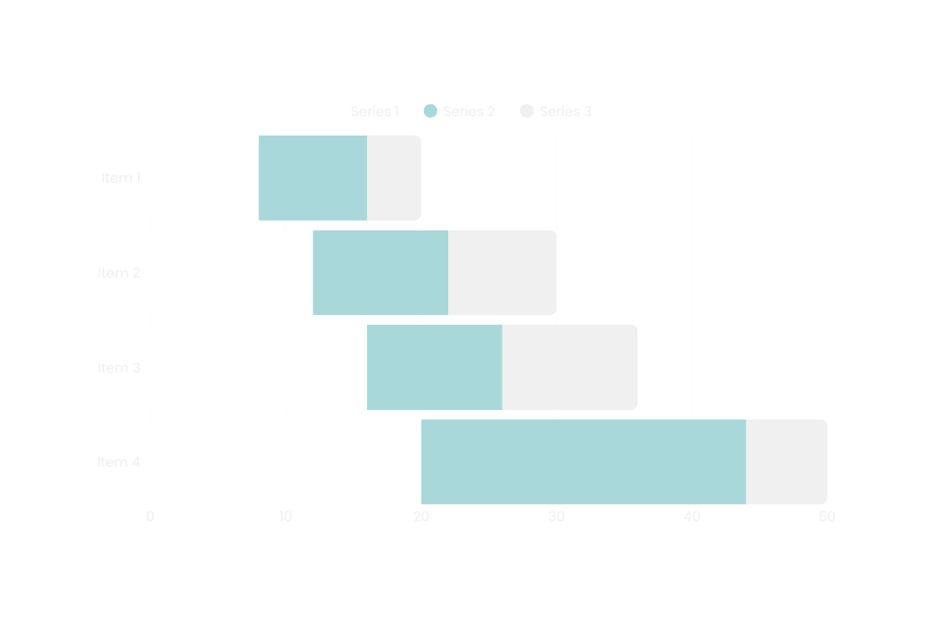
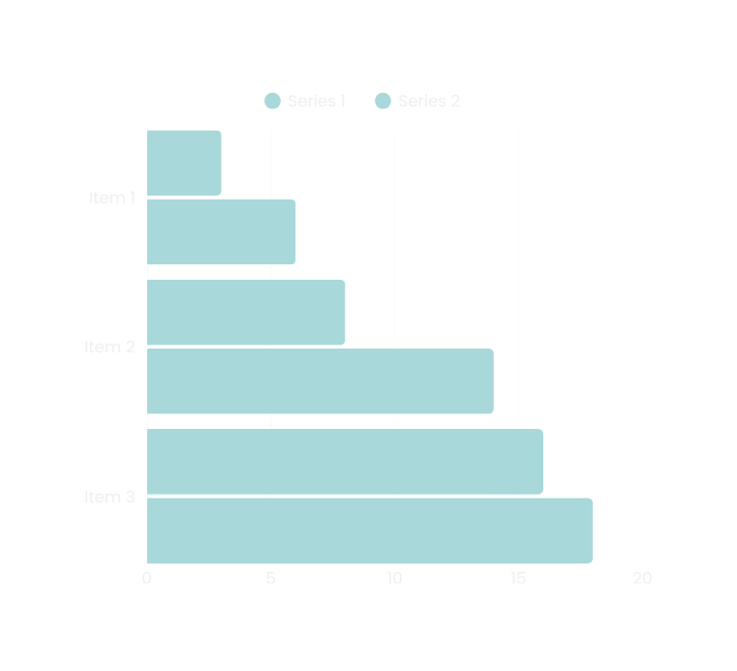
EDA
Discovering Sales Patterns

Slide 5
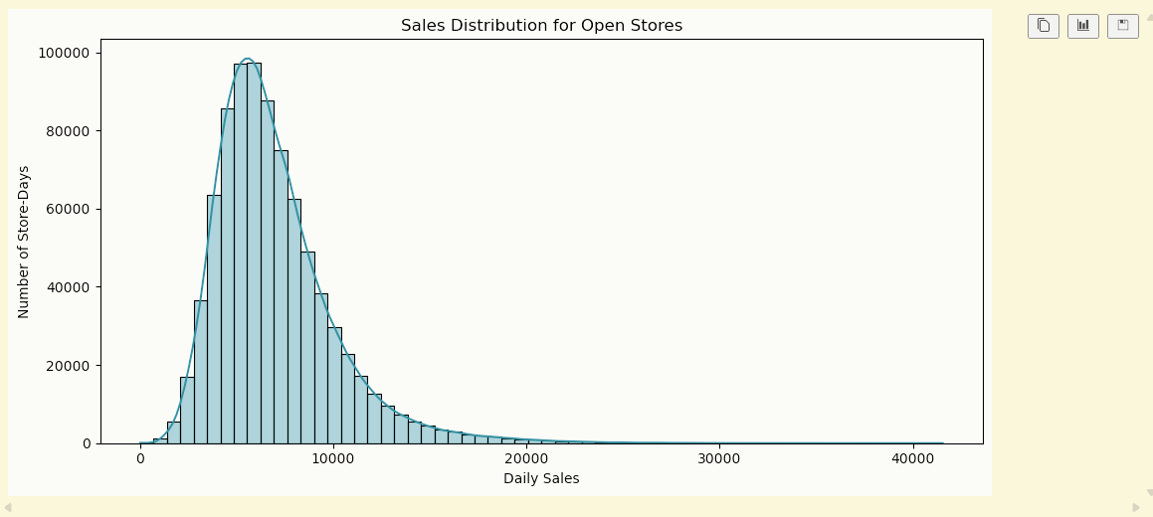
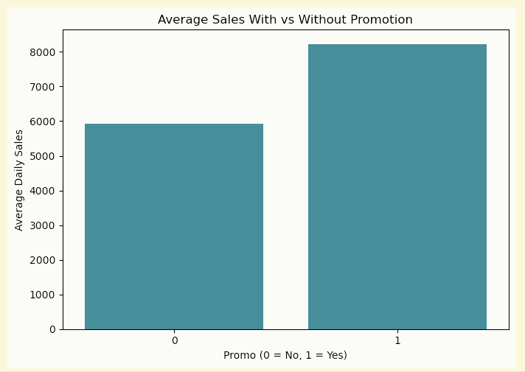
GRAPHS

Slide 6
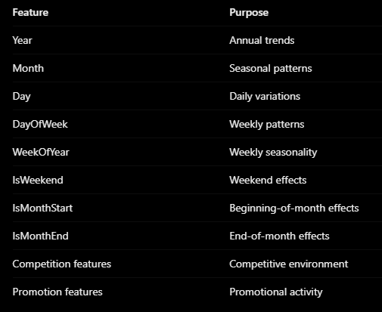
  Combined sales and store metadata.
  Handled missing values.
  Processed categorical variables.
  Prepared training and validation datasets.
  Maintained a chronological validation split.
FEATURE ENGINEERING

Slide 7
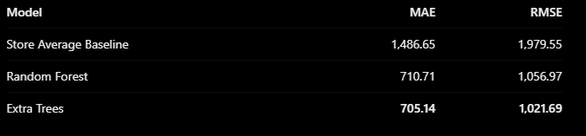
MACHINE
LEARNING
MODELS EXPLOERED
  Store-average baseline model.
  Random Forest Regressor.
  Extra Trees Regressor.
  Customer forecasting model using Extra Trees.
  Global LSTM for time-series forecasting.

Slide 8
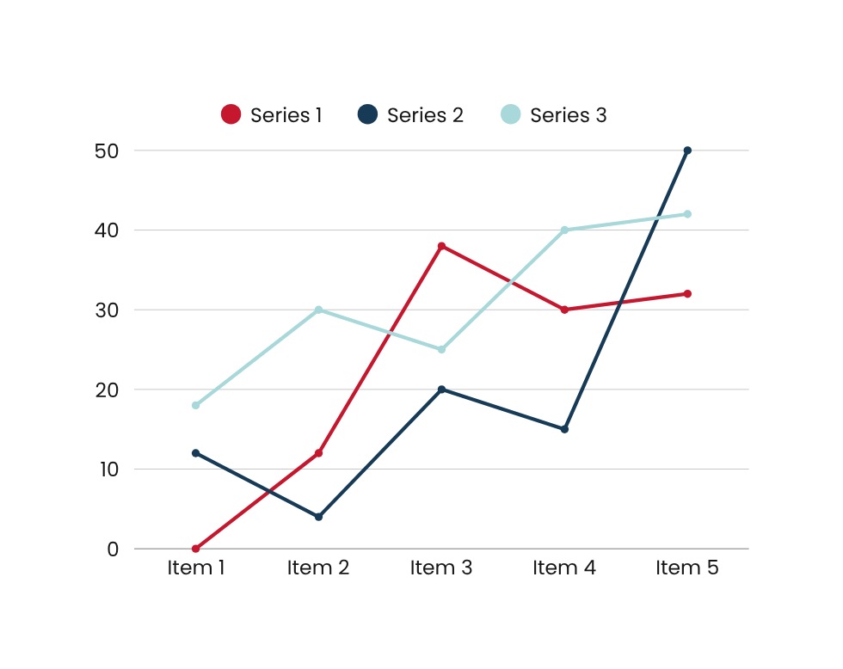
KEY RESULT
  MAE: 55.56
  RMSE: 79.40
LSTM:
  Developed a global time-series forecasting model.
  Saved the trained model and preprocessing artifacts.
Evaluation metrics:
  MAE: Average absolute prediction error.
  RMSE: Penalizes larger prediction errors more heavily.

Slide 9


MLflow – Experiment Tracking
  Recorded model training experiments.
  Tracked model performance and parameters.
  Used SQLite-backed experiment storage.
  Maintained experiment history.
DVC – Data Version Control
  Initialized DVC for dataset tracking.
  Tracked training, testing and store datasets.
  Created Git-tracked dataset snapshots.
  Demonstrated dataset version changes.
Streamlit – Interactive Application
Developed an interactive forecasting dashboard with:
  Store selection.
  Custom date-range selection.
  Promotion and holiday controls.
  Sales and customer predictions.
  Performance visualizations.
  CSV forecast downloads.
EXPERIMENTAL TRACKING
DATA VERSIONING
DEPLOYMENT

Slide 10
RESULTS &
CONCLUSION
Project achievements:
  Processed over one million training records.
  Identified important sales and customer patterns.
  Improved validation MAE by approximately 52.6% over the baseline.
  Developed separate sales and customer forecasting models.
  Explored global LSTM forecasting.
  Implemented MLflow experiment tracking.
  Established DVC dataset versioning.
  Built an interactive Streamlit application.
Business applications:
  Better inventory planning.
  Improved staffing decisions.
  Promotion planning.
  Understanding customer traffic.
  Supporting store-level business decisions.
Future improvements:
  More advanced time-series models.
  Improved holiday and promotion forecasting.
  Automated model retraining.
  Integration with live retail data.

Slide 11
THANK YOU

